Slide 1
آشنایی ، استفاده و مدیریت آپاچی کافکا
طبقه ‌بندی: عادی
تاریخ: 1399/12/03

Slide 2
Introduction - Architecture - Concept
۱
Primary Elements
۲
Messages – Metadata- Schema
3
Messages - Order and Delivery
4
Consumers
5
Configuration and Dependency
6

Slide 3
Clustering – Scalability
7
Clustering - Partition
8
Clustering - Replication
9
Broker – Fail Detection - Imbalance
10
Logs – Compression - Retention
11
Security – TLS – Authentication - Authorization
12

Slide 4
1 - Introduction - Architecture and Concept

Slide 5
Introduction
Community
Distributed event streaming platform
Capable of handling trillions of events a day
Based on an abstraction of a distributed commit log
Created and open sourced by LinkedIn in 2011

Slide 6
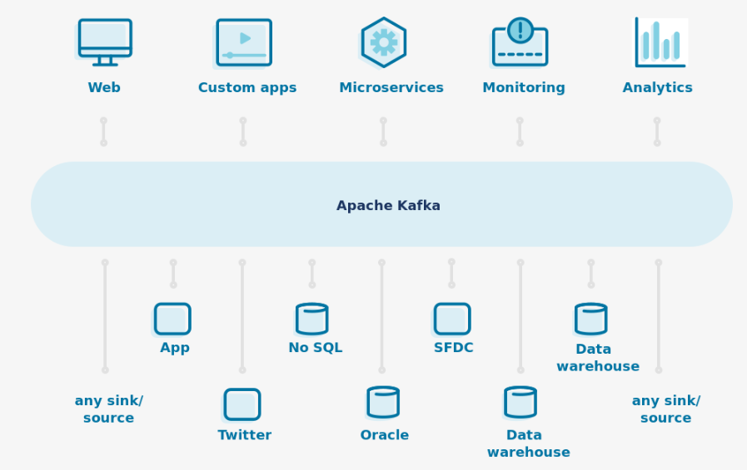
Introduction
Where Apache Kafka fits in

Slide 7
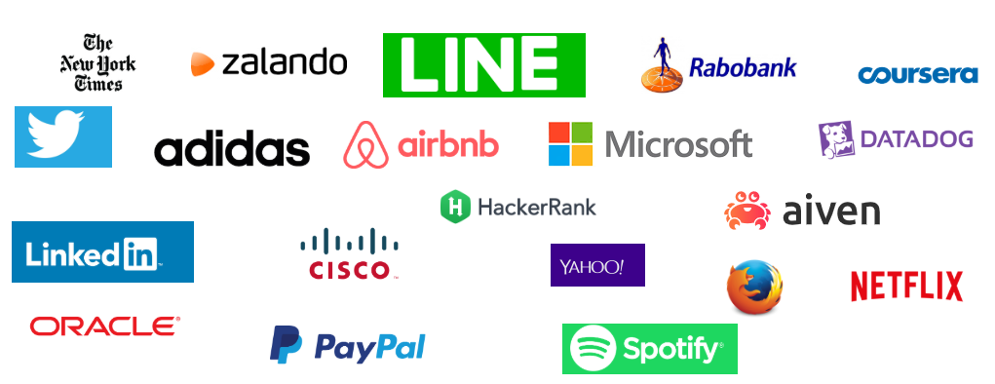

Usage
Thousands of companies are built on Kafka

Slide 8
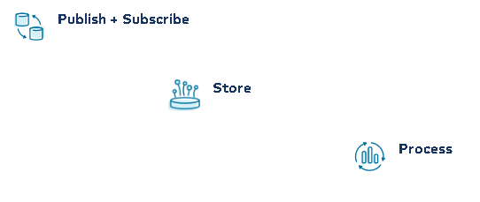
How can Kafka help you

Slide 9
Architecture
How does Kafka work?
Kafka is a distributed system
Consisting of servers and clients
Communicate via a high-performance TCP

Slide 10

Kafka Client
Java
Scala
C/C++
Python
Go (AKA golang)
Erlang
.NET
Clojure
Ruby
Node.js
Proxy( Http Rest)
Perl
Rust
Swift
PHP

Slide 11
2 - Primary Elements

Slide 12
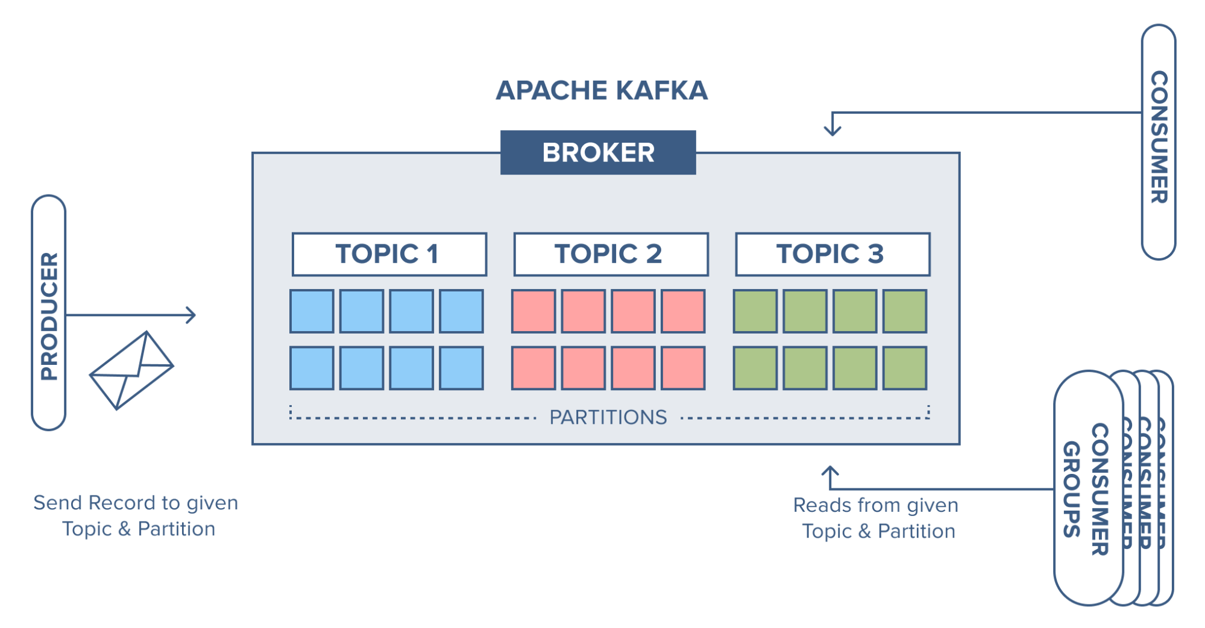
Main Concepts & Terminology

Slide 13
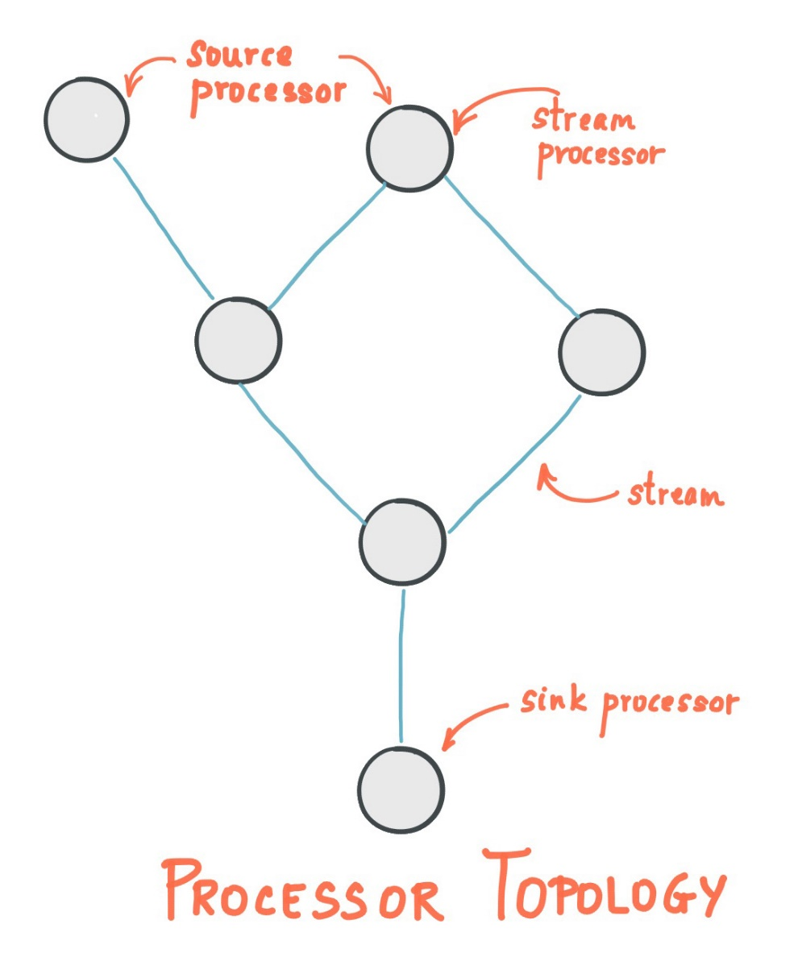
Stream Processing Topology

Slide 14
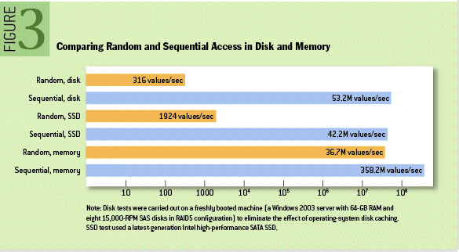
Persistence
Don’t fear the file system

Slide 15
3 - Messages – Metadata- Schema

Slide 16
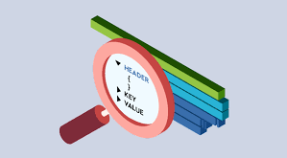
Message Metadata
Use the power of record headers

Slide 17
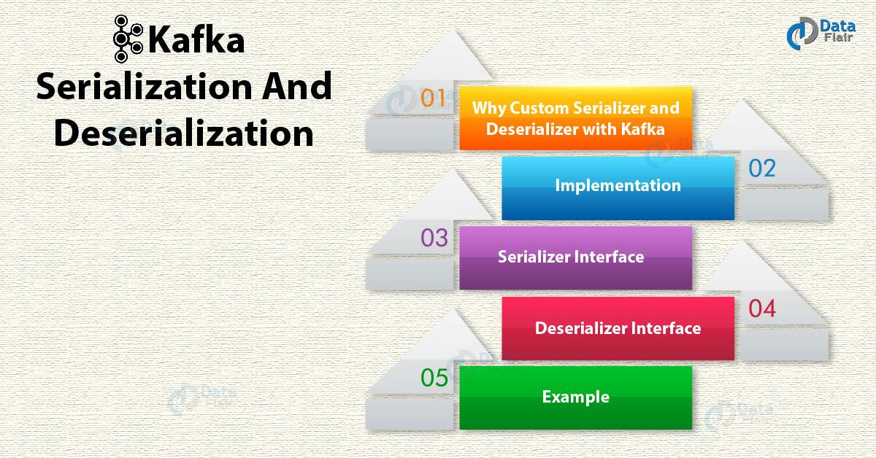
Message Schema

Slide 18
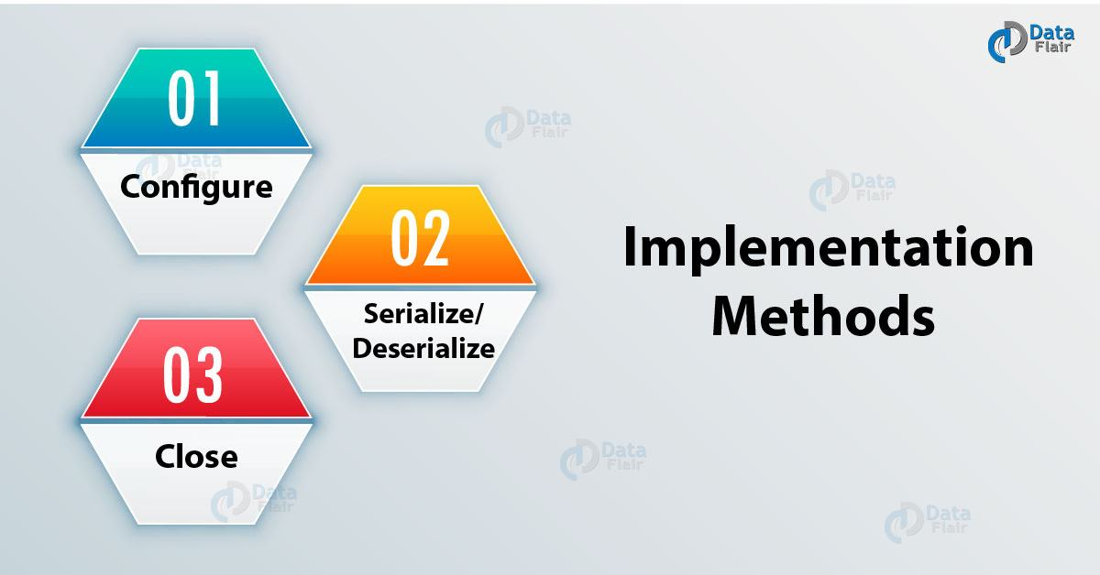
Message Serializer & Deserializer

Slide 19
Serializer Interface
public interface Serializer extends Closeable {
void configure(Map<String, ?> var1, boolean var2);
byte[] serialize(String var1, T var2);
void close();
}

Slide 20
Deserializer Interface
public interface Deserializer extends Closeable {
void configure(Map<String, ?> var1, boolean var2);
T deserialize(String var1, byte[] var2);
void close();
}

Slide 21
Example
public class User {
private String name;
private int age;
// Constructor
// Getter & Setter
}

Slide 22
Example
public class UserSerializer implements Serializer {
@Override public void configure(Map<String, ?> map, boolean b) {
}
@Override public byte[] serialize(String arg0, User arg1) {
return new ObjectMapper().writeValueAsString(arg1).getBytes();
}
@Override public void close() {
}
}

Slide 23
Example
public class UserDeserializer implements Deserializer {
@Override public void close() {
}
@Override public void configure(Map<String, ?> arg0, boolean arg1) {
}
@Override public User deserialize(String arg0, byte[] arg1) {
return new ObjectMapper().readValue(arg1, User.class);
}
}

Slide 24
Producer and Consumer Configuration
// Producer side
props.put("value.serializer",
“com.isc.nps.npsd.kafka.serializers.UserSerializer");
//Consumer side
props.put("value.deserializer",
"com.isc.nps.npsd.kafka.deserializer.UserDeserializer");

Slide 25
4 - Messages - Order and Delivery

Slide 26
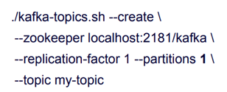
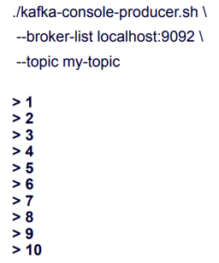
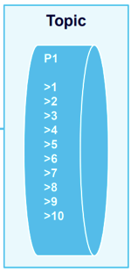
Message Order - Single Partitioning

Slide 27
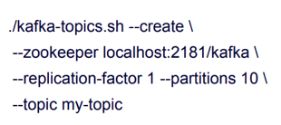
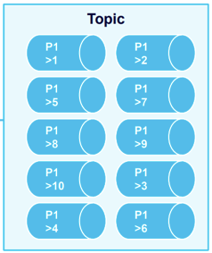
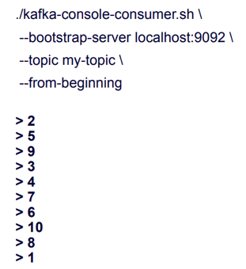
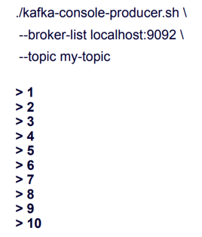
Message Order - Multiple Partitioning

Slide 28
Message Order
How to achieve strict ordering?
Most businesses require things to be in the correct order
You must use only one partition
Prefer messages to be ordered based on a certain property in the message
Use multiple partitions and still reach the result you wish

Slide 29
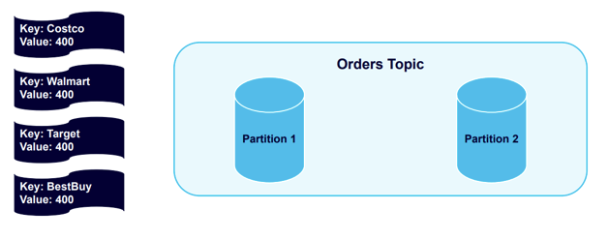
Message Order - Keying

Slide 30
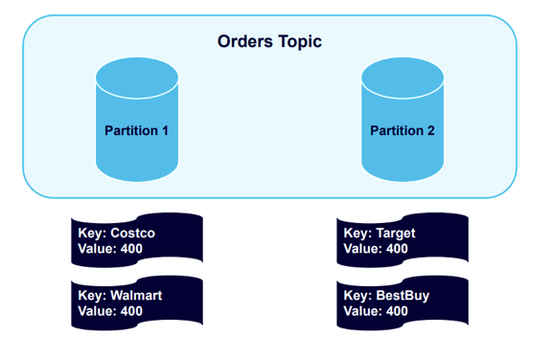
Message Order - Keying

Slide 31
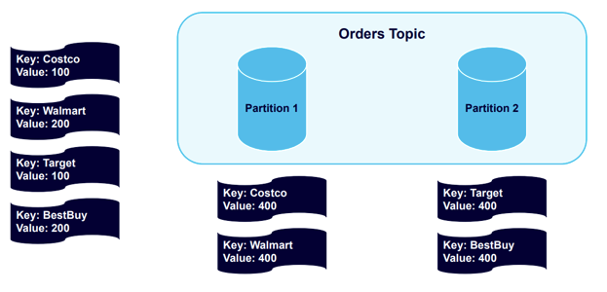
Message Order - Keying

Slide 32
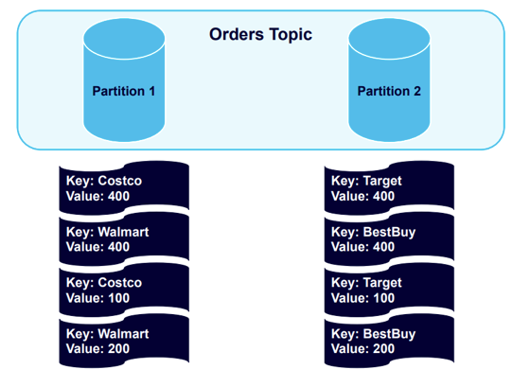
Message Order - Keying

Slide 33
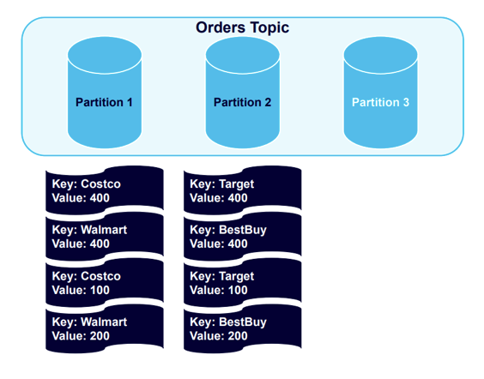
Message Order - Keying and Partition Rebalancing

Slide 34
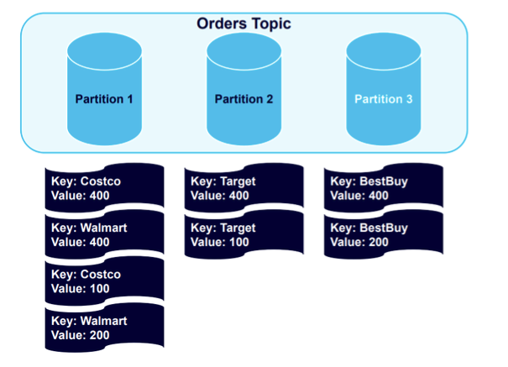
Message Order - Keying and Partition Rebalancing

Slide 35
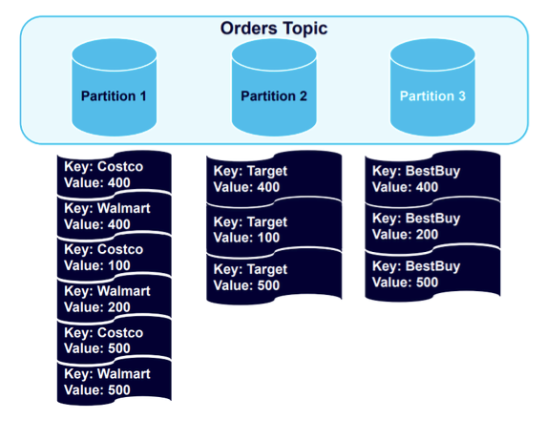
Message Order - Keying and Partition Rebalancing

Slide 36
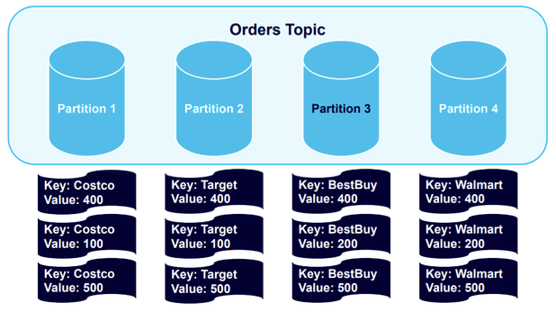
Message Order - Keying and Partition Rebalancing

Slide 37
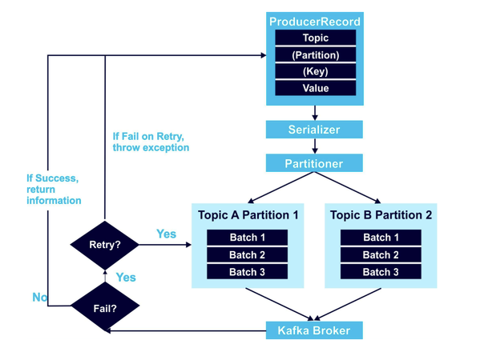
Message Order - Ensuring that Data is Always Sent in Order

Slide 38
Message Delivery and Durability
For Data Durability
Producer configuration setting “acks”
“acks” specifies how many acknowledgement receives
To consider record / event delivered to the broker.
“acks” options choose
none
One
all

Slide 39
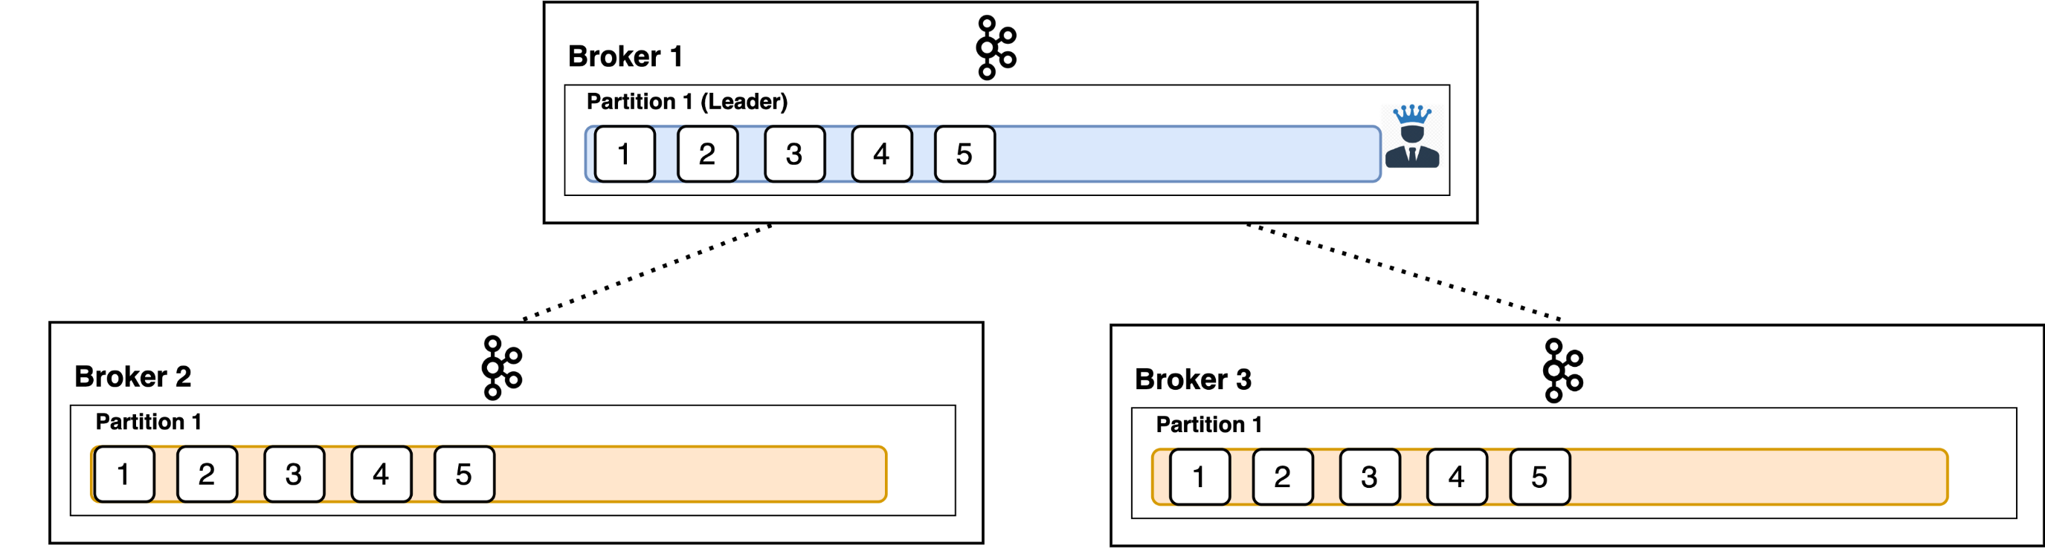
Message Delivery and Durability – acks - replication

Slide 40
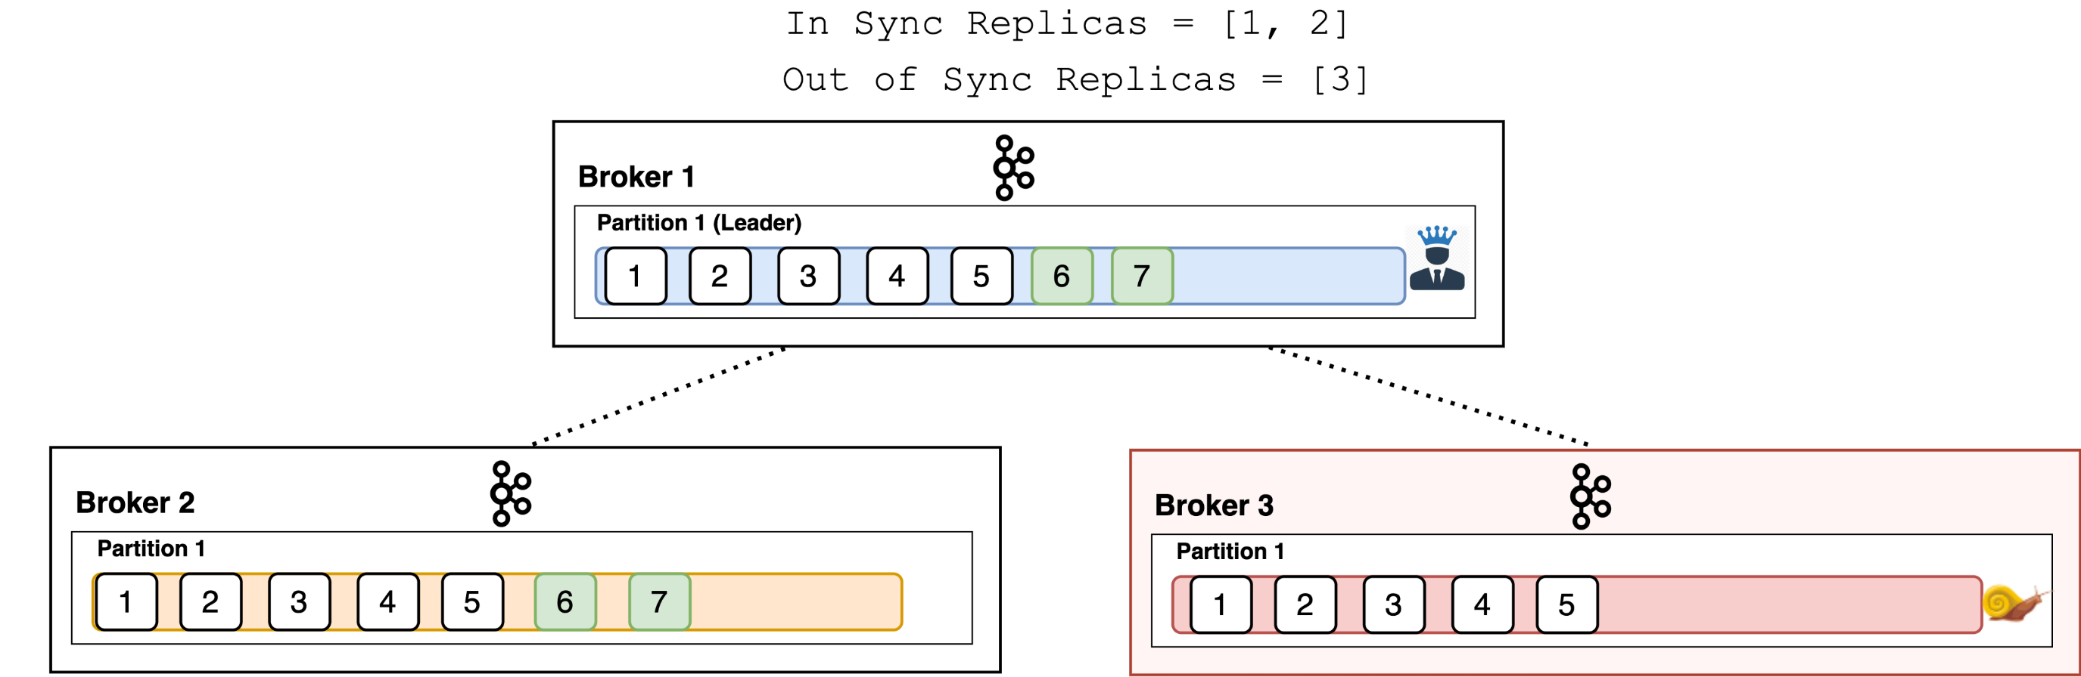
Message Delivery and Durability – acks – isr

Slide 41
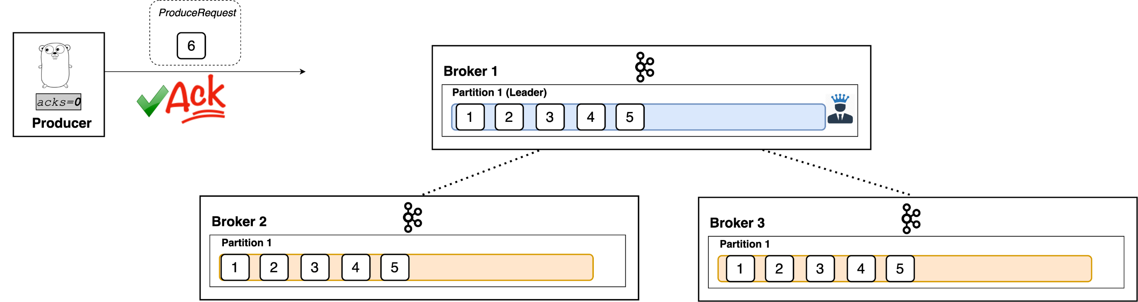
Message Delivery and Durability – acks = 0

Slide 42
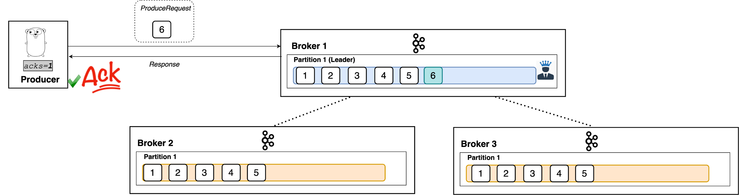
Message Delivery and Durability – acks = 1

Slide 43
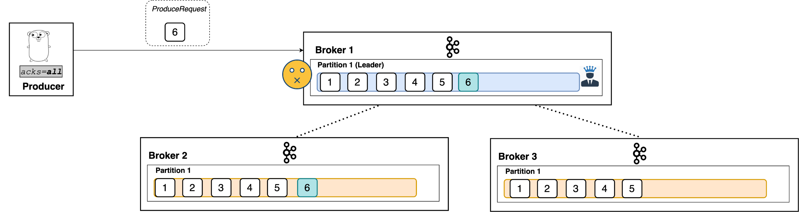
Message Delivery and Durability – acks = all

Slide 44
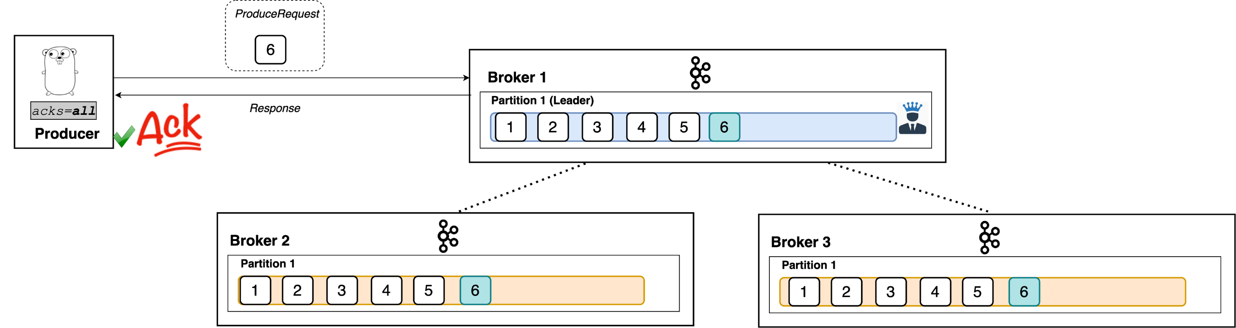
Message Delivery and Durability – acks = all

Slide 45
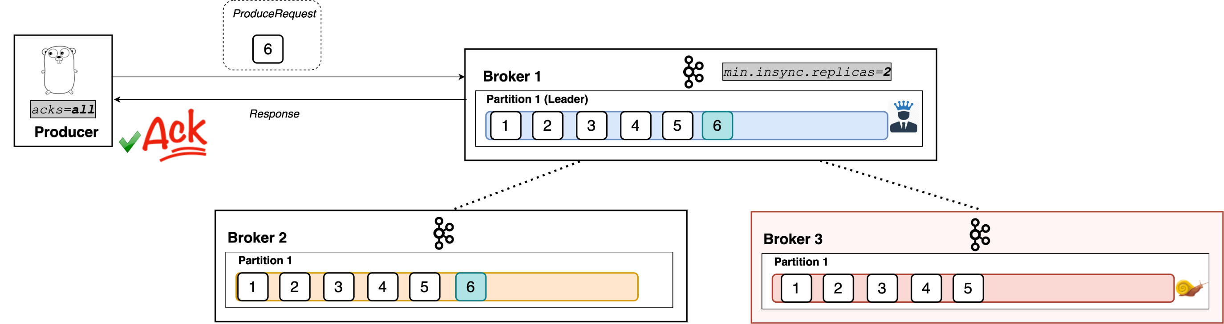
Message Delivery and Durability – Minimum In-Sync Replica

Slide 46
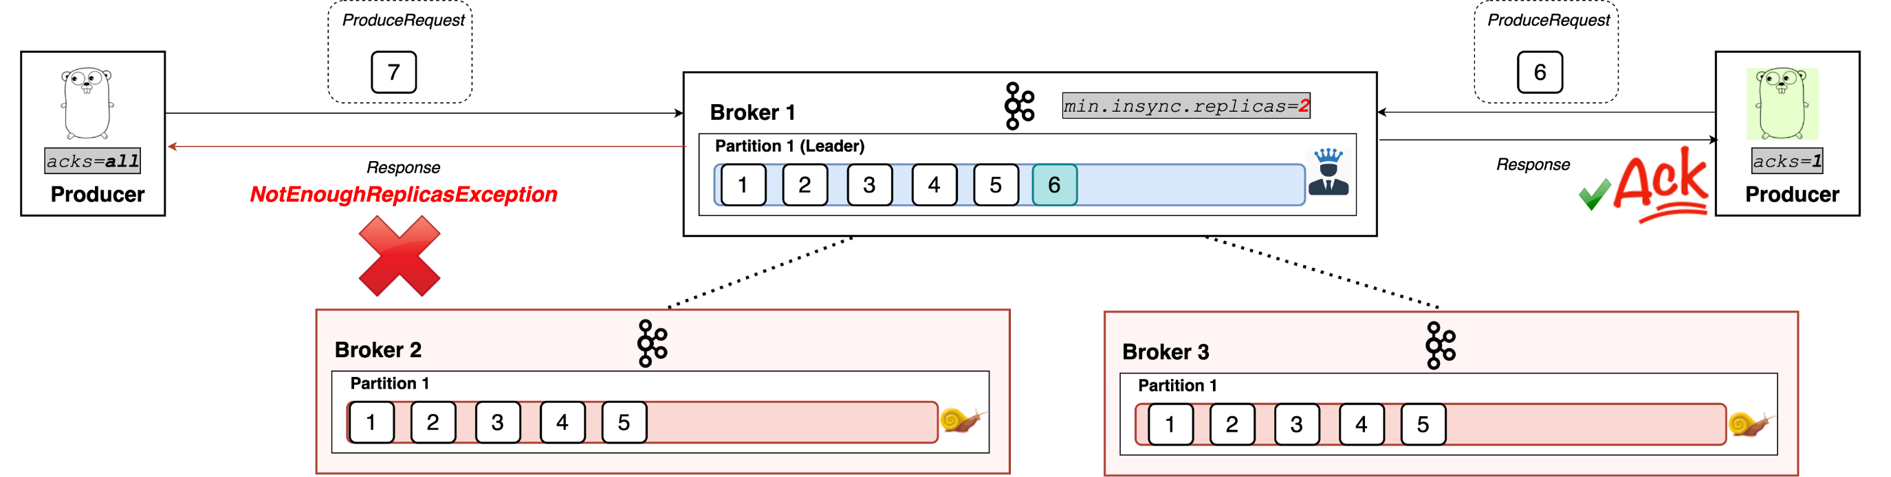
Message Delivery and Durability – Minimum In-Sync Replica

Slide 47
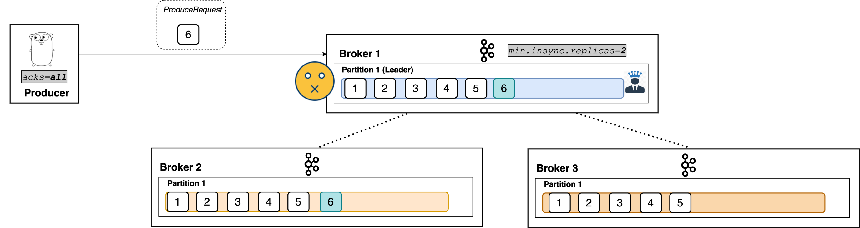
Message Delivery and Durability – Minimum In-Sync Replica

Slide 48
Processing Guarantees – Issues
How do we guarantee all messages are processed?
How do we avoid or handle duplicate messages?

Slide 49
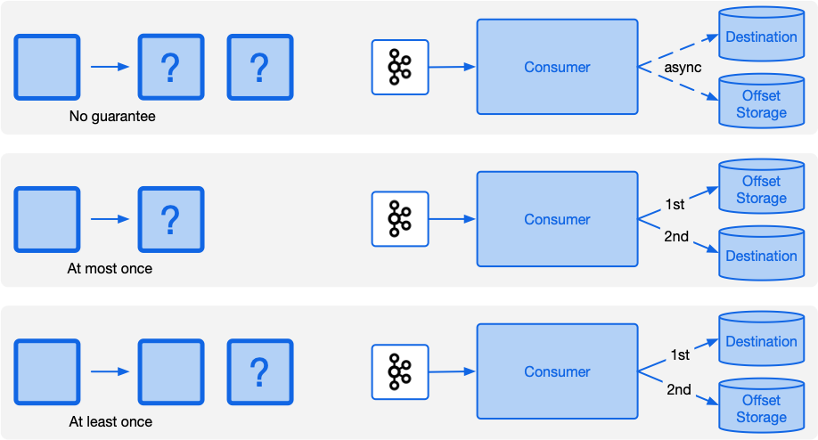
Processing Guarantees – Concept

Slide 50
5 - Consumers

Slide 51
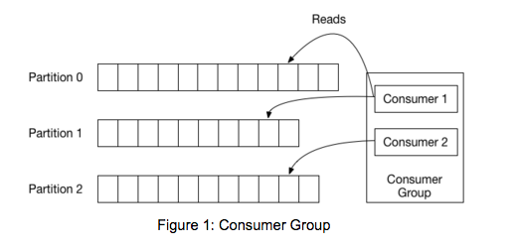
Consumer & Consumer Group
Topic
Producer - Tail
Consumer – Own Place
Scale - Partition
Consumer Group
Old - Zookeeper for Group Management
New – Group Coordination Protocol

Slide 52
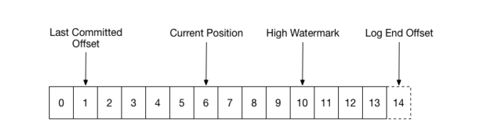
Consumer Position

Slide 53
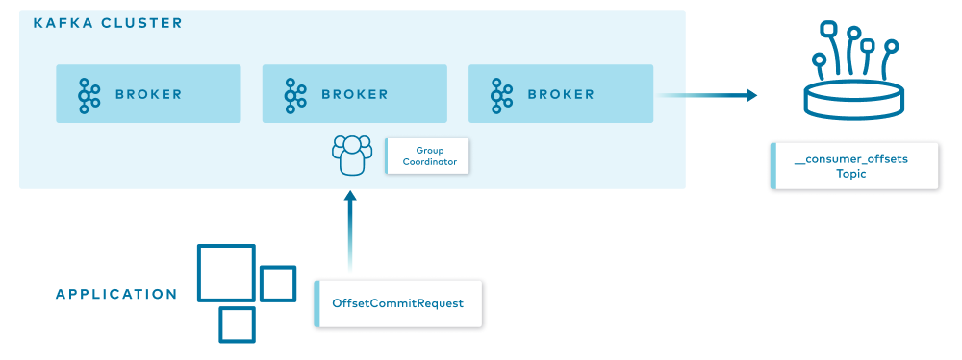
Consumer – Offset Storage

Slide 54
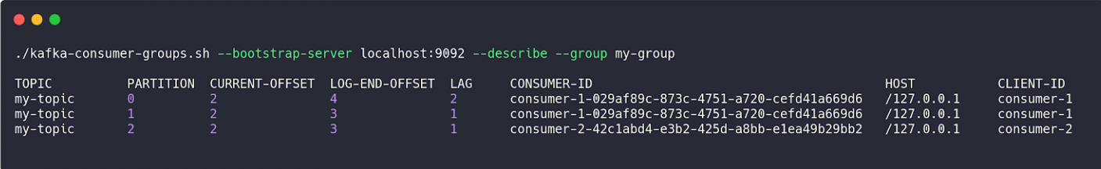
Consumer – Describe using CLI

Slide 55
Consumer – Lag
Key Performance Indicator - KPI
Delta between last committed to last produces
Keep lag to minimum
Kafka Persistence is based on retention
Lag persists
Lose data at some point in time

Slide 56
Consumer Lag Explore
Kafka Lag Exporter
native Kubernetes support
contained time-based lag monitoring
Burrow
Burrow is an active LinkedIn project
Has an active community
Remora
Was created after Zalando spent some time using Burrow.
Has Datadog and CloudWatch integration

Slide 57
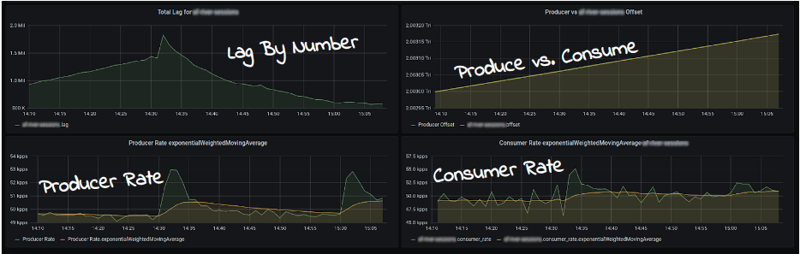
Burrow dashboards

Slide 58
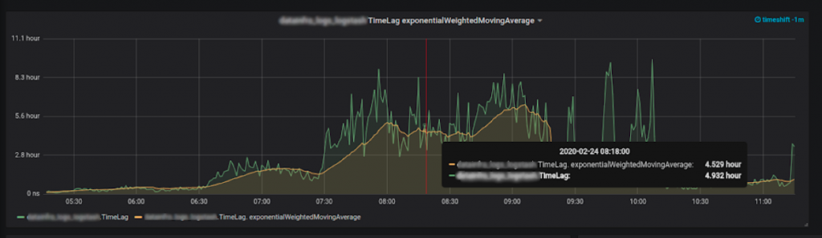
More Important – Time-Based

Slide 59
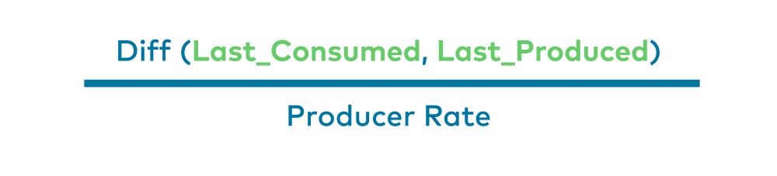
Consumer Lag – Time Lag

Slide 60
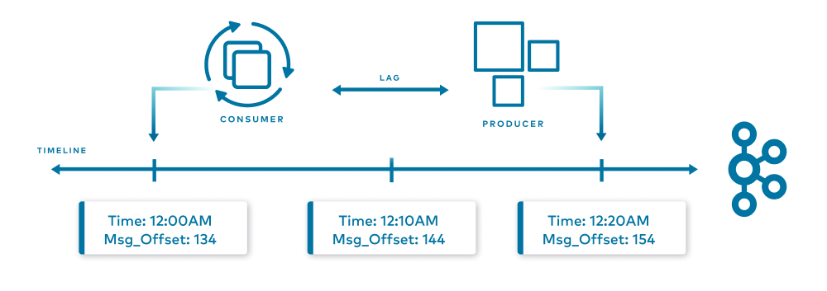
Consumer Lag – Time Lag - Visual

Slide 61
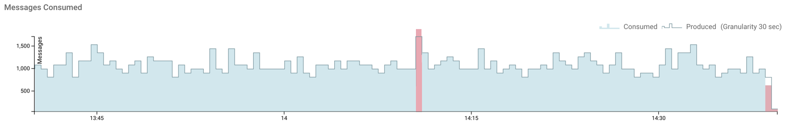
Consumer - Over and Under Consumption

Slide 62
6 - Configuration and Dependency

Slide 63
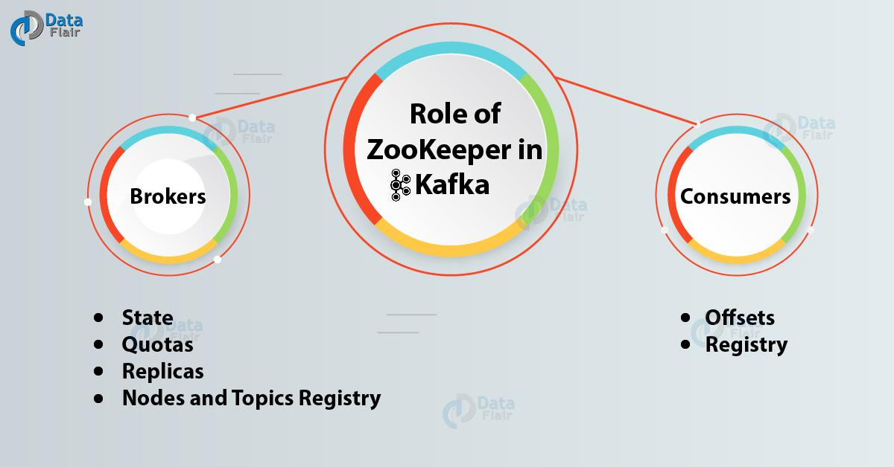
Dependency - Zookeeper

Slide 64
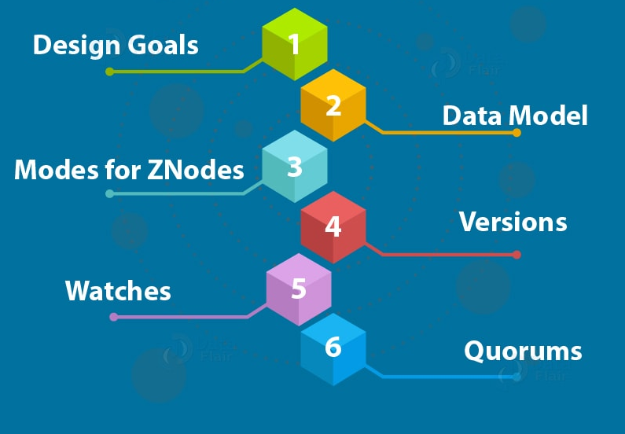
Zookeeper Architecture

Slide 65
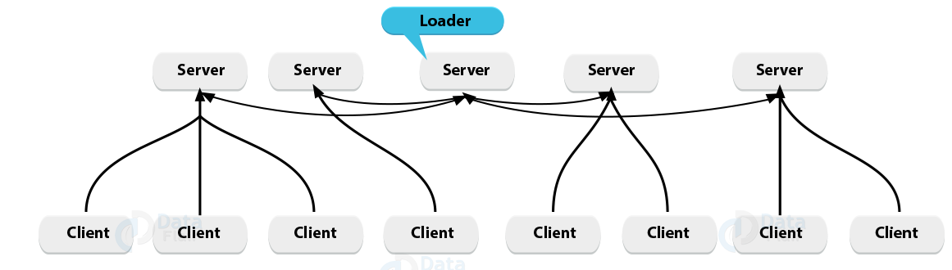
Zookeeper – Client / Server Architecture

Slide 66
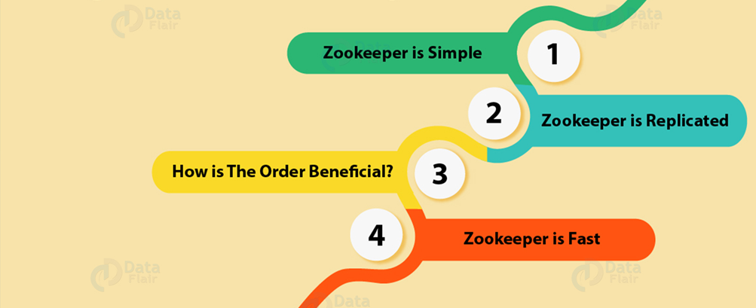
Design Goals of Zookeeper Architecture

Slide 67
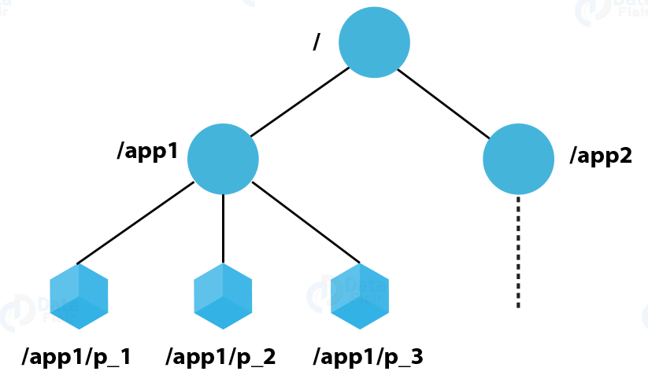
Data Model in ZooKeeper

Slide 68
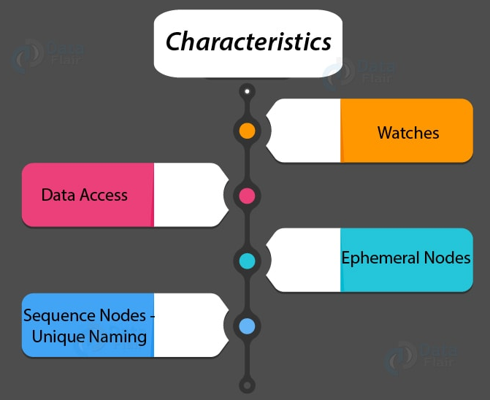
Zookeeper ZNodes

Slide 69



Zookeeper – Versions

Slide 70

Zookeeper – Watches

Slide 71

Zookeeper - Quorums

Slide 72

Hardware of Zookeeper

Slide 73

Zookeeper - Monitoring

Slide 74




Kafka Requirement

Slide 75
Kafka – Important Configuration
Level | Important Configuration
Operation System – OS | File descriptor limits Max socket buffer Max number of memory map
Producer | acks compression batch size
Consumer | fetch size
Java | 8 and 11

Slide 76
Kafka – Linkedin busiest Cluster
Cluster Status
60 brokers
50k partitions (replication factor 2)
800k messages/sec in
300 MB/sec inbound
1 GB/sec outbound
JVM Argument
-XX:+UseG1GC
-XX:MaxGCPauseMillis=20
-XX:InitiatingHeapOccupancyPercent=35
-XX:G1HeapRegionSize=16M
-XX:MinMetaspaceFreeRatio=50
-XX:MaxMetaspaceFreeRatio=80
-XX:+ExplicitGCInvokesConcurrent
GC Result
90% GC pause time of about 21ms
less than 1% young GC per second

Slide 77
7 - Clustering – Scalability, Fault Tolerant and High Availability

Slide 78

Scaling – Vertical vs Horizontal

Slide 79

Scale-out architecture with Kafka

Slide 80

Fault Tolerance

Slide 81

Availability

Slide 82

Ensuring Client Connectivity

Slide 83

The Kafka Consensus Architecture

Slide 84

The Replication Protocol

Slide 85

Leader Fail-Over

Slide 86

Network Partitions

Slide 87

Scenario 1: A follower cannot see the leader, but can still see Zookeeper

Slide 88

Scenario 2: A leader cannot see any of its followers, but can still see Zookeeper

Slide 89

Scenario 3: A follower can see the leader, but cannot see Zookeeper

Slide 90

Scenario 4: A leader can see its followers, but cannot see Zookeeper

Slide 91

Scenario 4. The leader on Broker 1 becomes a follower after the network partition is resolved

Slide 92

Scenario 5: A follower is completely partitioned from both the other Kafka nodes and Zookeeper

Slide 93

Scenario 6: A leader is completely partitioned from both the other Kafka nodes and Zookeeper

Slide 94

Scenario 6: The original leader becomes a follower after the network partition is resolved

Slide 95
Scenarios Conclusions - Message Loss
* leader fail-over where acks=1
* unclean fail-over with acks=all
* A leader isolation from Zookeeper with acks=1
* A fully isolated leader, even acks=all if min.insync.replicas=1
* Simultaneous failures of all nodes of a partition.
* messages are acknowledged once in memory, some messages may not yet have been written to disk.

Slide 96
8 - Clustering – Partition Assignment and Rebalancing

Slide 97

Let’s go back to some basics

Slide 98
The Rebalance Protocol, in a Nutshell
Rebalance/Rebalancing: the procedure that is followed by a number of distributed processes that use Kafka clients and/or the Kafka coordinator to form a common group and distribute a set of resources among the members of the group.

Slide 99

Apache Kafka Rebalance Protocol and components

Slide 100

Join Group Request

Slide 101

Join Group Response

Slide 102

Sync Group Request

Slide 103

Sync Group Response

Slide 104

Heartbeat

Slide 105

Consumer — Rebalance Protocol — Leave Group

Slide 106

Consumer — Rebalance Protocol — Rejoin

Slide 107

Consumer — Rebalance Protocol — Restart

Slide 108

Consumer — Rebalance Protocol — Timeout

Slide 109

Static Membership

Slide 110

Static Membership - Restarting or Killed due to transient failure

Slide 111
Incremental Cooperative Rebalancing
* New embedded protocols
* Improve the resource availability of each member
* Minimizing stop-the-world effect
* The basic idea behind is perform rebalancing
* Incrementally
* In cooperation

Slide 112
KIP - Rebalancing Protocols
* KIP : Kafka Improvement Proposals
* KIP-345: Introduce static membership protocol to reduce consumer rebalances
* Released: 2.4.0
* Last modified: Sep 09 2019
* KIP-429: Kafka Consumer Incremental Rebalance Protocol
* Released: 2.4.0
* Last modified: Mar 16 2021

Slide 113
The Partition Assignor Strategies
* What is it?
Protocol to customize how partitions are assigned to the group members.
* How to configure?
Configurable through the consumer property
partition.assignment.strategy
* Built-in
* Range
* RoundRobin
* StickyAssignor

Slide 114
Specify a Partition Assignor - code snippet
Properties props = new Properties();
...
props.put(ConsumerConfig.PARTITION_ASSIGNMENT_STRATEGY_CONFIG, StickyAssignor.class.getName());
KafkaConsumer<String, String> consumer =
new KafkaConsumer<>(props);
//...

Slide 115
Different strategy Issue
* All consumers which belong to the same group must have one common strategy declared
* An assignment configuration inconsistent with other group members
org.apache.kafka.common.errors.InconsistentGroupProtocolException: The group member’s supported protocols are incompatible with those of existing members or first group member tried to join with empty protocol type or empty protocol list.

Slide 116

Range Assignor

Slide 117

Round Robin Assignor

Slide 118

Round Robin Assignor with reassignment

Slide 119

Sticky Assignor

Slide 120
Implementing a Custom Strategy
public interface PartitionAssignor { Subscription subscription(Set<String> topics); Map<String, Assignment> assign(
Cluster metadata, Map<String, Subscription> subscriptions); void onAssignment(Assignment assignment); String name(); }

Slide 121

Simple Failover strategy

Slide 122

Simple Failover strategy – C1 fails

Slide 123
9 - Clustering - Replication, Leaders and Followers

Slide 124

Four partitions distributed across three brokers

Slide 125

Producer, Consumer And Leader

Slide 126

Partition Fail-Over - Broker 3 dies

Slide 127

Partition Fail-Over - Broker 1 dies too

Slide 128

Leaders remain on broker 2

Slide 129

Unbalanced leaders after recovery of broker 1 and 3

Slide 130

Replica leaders rebalanced

Slide 131
10 - Broker – Fail Detection - Imbalance

Slide 132
Controller Broker
* A distributed system must be coordinated.
* Event happens & React in an organized way
* It is a normal broker that simply has additional responsibility
* Additional responsibility
* Keeping track of nodes in the cluster
* Handling nodes that leave, join or fail
* There is always exactly one controller broker in a Kafka cluster.

Slide 133

Handle a node leaving the cluster

Slide 134

Split Brain

Slide 135

Split Brain - Broker 2 won the race

Slide 136

Broker 3 wake up

Slide 137

Epoch Number

Slide 138
11 - Logs – Compression - Retention

Slide 139

Why do I need to reduce message size?

Slide 140

Message Format

Slide 141

Lingering

Slide 142

Without Lingering VS Using Lingering

Slide 143

Compression

Slide 144

Support for Zstandard Compression (KIP-110)

Slide 145

Schema

Slide 146
Conclusion
Lingering needs you wait a bit more to gather more records.
Compression uses more CPU usage but will reduce the amount of IO.
Using Avro impose
Dependency on clients (consumer and producer)
have Confluent Schema Registry to keep the schema of the records.

Slide 147

Retention

Slide 148

Time Based Retention

Slide 149

Size Based Retention

Slide 150

Log Cleanup Policies

Slide 151

Compact Policy

Slide 152

Log Cleaner

Slide 153
FAQ – Log Cleaner
Does Log Cleaner impacts Read performance?
Does offset of message gets changed after compaction?
Does Log Cleaner also deletes Tombstone messages?
Does order of messages gets changed after compaction?

Slide 154
12 - Security – TLS – Authentication - Authorization

Slide 155

The need for security

Slide 156

Problems Security is solving

Slide 157

Encryption

Slide 158

Authentication

Slide 159

Authorization

Slide 160
زمستان – 1399

